Slide 1

Music Generation
Project Supervisor : Project By :
Dr. Anurag Singh Jerin Joseph - 181210025
Mayank Bhandari - 181210030
NIT Delhi
*
Notes:
*
Chandra prakash

Slide 2
Problem Statement
Music Industry provides a wide range of genres, from POP to JAZZ to Classical to Country music. Countless artists including singers, composers, writers, musicians etc., uses a wide variety of instruments to make new music.
It is difficult of people who have other jobs to take their time and learn new instruments in order to create a new music piece.
Musicians and composers needs to be creative and innovate all the time to make create something new.
NIT Delhi
*

Slide 3
Problem Statement
Helps people to compose songs by just adjusting the pitch, tempo and allowing the AI to create the music
Inspires composers to create a new masterpiece
Integration with several music applications making it easier for users to compose songs
NIT Delhi
*

Slide 4
Motivation
Development in music generation from various companies shows its true potential and what it could achieve in the future.
AIVA, an artificial music generator, released its own copyrighted albums with generated soundtrack in EDM genre
Jukedeck developed an AI music composer which creates its own music which is been trained using deep neural network to understand music at a granular level
Magenta is a python library used to train its pre-built model using different data and convert it to music for its users. It help developers to add the generation model into its music applications.
WaveNet is a speech generation model which predict the next sound by understanding the speech pattern from its input. It uses a type of convolutional neural network

Slide 5
Development Steps
Data Collection
Converting data to input
Model Development and Training
Output
Conversion of output to the required sound format

Slide 6
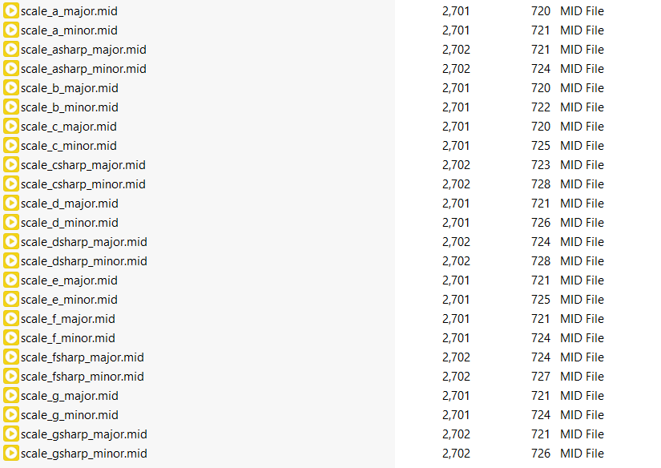
Data Collection
Appropriate Music files should be used for
the training of the model.
MIDI files are used for the dataset format.
Basic piano scales and piano classical
music are used.
The files are all using the piano
instrument and of MIDI format.
Fig 1:- midi files from kaggle dataset

Slide 7
MIDI File
MIDI (Music Instrument Digital Interpretation) is a standard protocol used to interact with multiple musical devices to record, synthesize and play music.
Data in MIDI files consist of tracks.
Each track consist of events which tell the note, velocity and the time
duration to be played.
Contains additional information like the tempo and resolution.

Slide 8
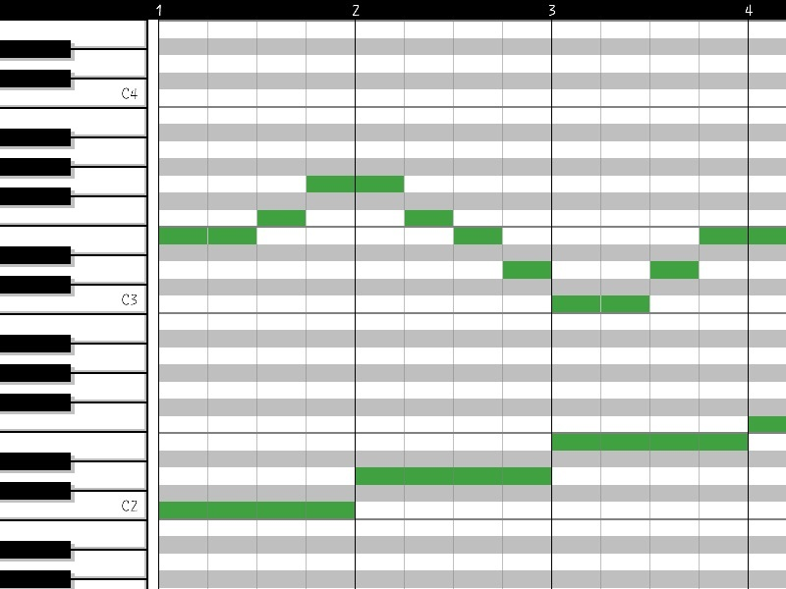
Converting Data to Input
The input will be in the form of a piano roll.
Piano Rolls is a format to represent
music where y-axis is the notes played
and x-axis is the timestamp.
Piano Roll will be represented as a
matrix (Total Notes x Time) and each
cell tell if the note is played or note at a
particular interval of time Fig 2:- Piano roll representation
The piano roll matrix would be converted into sequences for the model

Slide 9
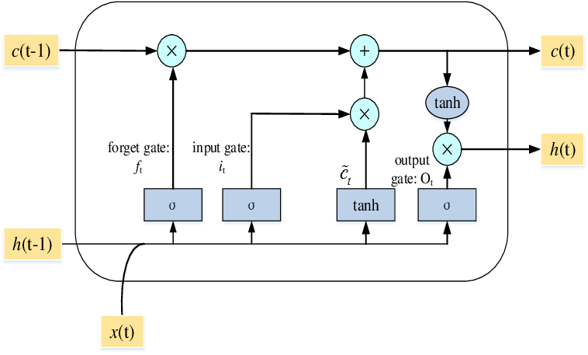
Model Development and Training
Models we considered for this use case are
mentioned below.
Wave Net using CNN
Simple RNN and GRU
LSTM
Fig 3:- Basic architecture of the LSTM Model

Slide 10
Wave Net using CNN
This model is usually used for NLP. This model is based on a type of CNN Model. CNN models are usually used in the field of computer vision and not for audio. Using the original CNN model will not be able to create music efficiently and thus a feedback system is required.
This model was suggested for music generation since it runs sequence parallelly, but it doesn’t contain a feedback system hence we drop this model for the project.

Slide 11
Simple RNN
While coming across RNN models, we found that they are best suited model for our use case. Digging deeper into it, we come across LSTMs, that uses special units in addition to standard units. So we decided to move with this specialized RNN model named LSTM.

Slide 12
LSTM (Long Short-Term Memory)
RNN models, in general are usually suitable for purposes where a feedback system is required. Music generation highly rests on this concept only, where previous outputs are used for the next input. LSTMs are specialized in this domain, of carrying previous sequences for a longer period of time. This is helpful to produce meaningful music, as new generated music is inspired from the previous notes hit.
The LSTM model has various gates like the forget gate and the input gate which helps to send the previous outputs as feedback.

Slide 13
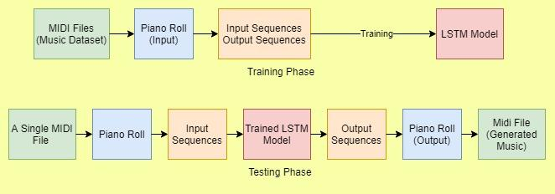
Music Generation Phases
Fig 4:- Steps followed for training and testing phase

Slide 14
MIDI to Piano Roll Conversion
The MIDI files are converted into Mido objects. To create the piano roll from the MIDI data, a suitable time slice must be chosen. A time slice represents a column in the piano roll matrix. With the ticks per time slice and the total time slice, the total number of columns for the piano roll can be obtained.
Ticks per Time Slice = TPS * Seconds per Time Slice
Number of Time Slices (Columns) = ceil (Total Ticks/ Ticks per Time Slice)

Slide 15
Piano Roll to Sequence Conversion
The piano rolls for all the MIDI files are split into sequence for training. An array of input sequence and an output sequence is generated from the piano rolls.
After generation of the sequences, the input sequence and output sequence matrix are shuffled. The shuffling of the sequence are performed to obtaining better training result.

Slide 16
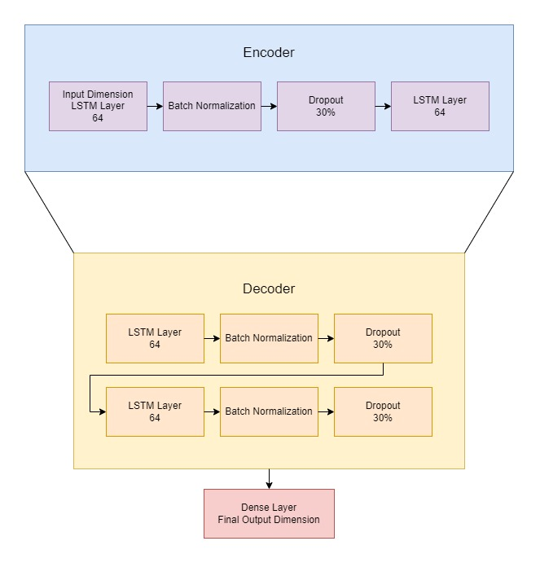
Model Training
Fig 5:- Encoder-Decoder structure for model training in LSTM model

Slide 17
The model used in the project is a Sequential LSTM Model. The model layers contain an encoder and a decoder where the encoder layers are used to extract the main features of the input sequence and the decoder sequence. An encoder-decoder model was the optimal model network for the project since there is lack of appropriate credible data, and complex models might not be properly trained to produce outcomes.

Slide 18
Problems faced
Low decrease in loss function
Reduced the data used
Used songs of similar tone for training
Used a different LSTM model
Generated output generates piano roll where no notes are played
Adds the selected song’s sequence again as the input

Slide 19
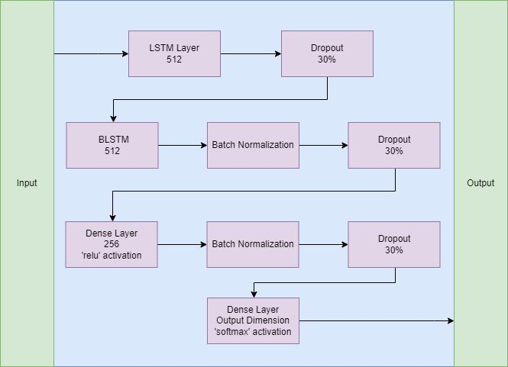
Enhanced Model using BLSTM
Fig 6:- Our “Enhanced Model using BLSTM”

Slide 20
This is a newly generated model which uses Bidirectional LSTM as one of its layers. The model generates a better result compared to the previous model with a much lower loss. This model contains 3 phases, the first involves a normal LSTM Layer. The second phase involves a BLSTM layer and the third phase involves 2 dense layers with ‘relu’ and ‘softmax’ activation.

Slide 21
Details of Sequential LSTM Model
The encoder consists of two LSTM layers with a dropout of 30 percent to prevent overfitting and batch normalization is used to make the training more effective. This data is then passed to the decoder with 2 more LSTM Layers followed with dropout and batch 21 normalization layers.
At the end of the decoder the data is passed through the Dense to fit the resultant data in the final output sequence dimension.
The optimizer used in the model is an Adam () optimizer and the loss function used is categorical cross entropy.

Slide 22
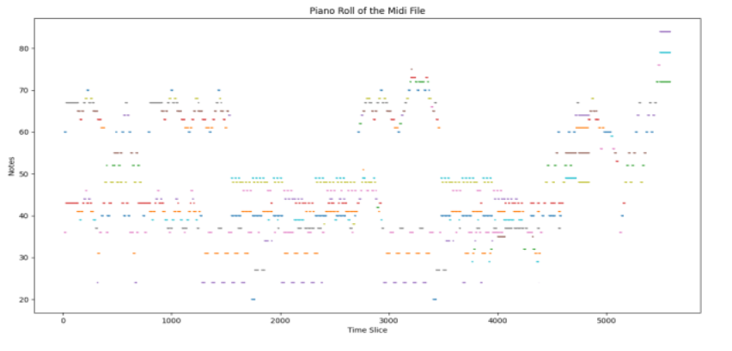
Results
Fig 7:- Plotting “Notes” vs “Time slice”

Slide 23
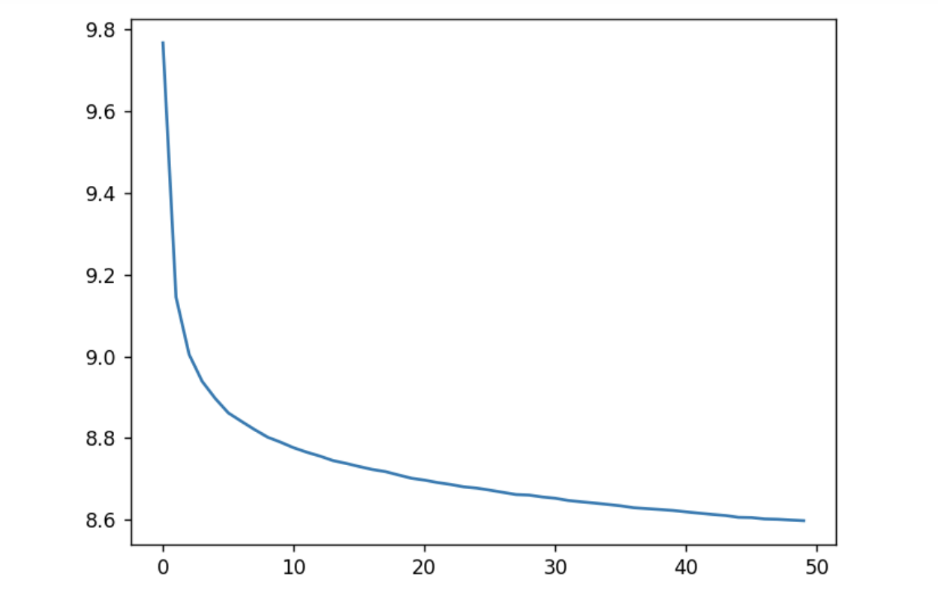
Results from Basic Model Training
Fig 8:- Plotting “loss curve” vs “epochs” for LSTM model

Slide 24
Y-axis : Loss value
X-axis : Number of epochs
The graph shows minor decrease in loss values for the basic model from 9.8 to 8.6

Slide 25
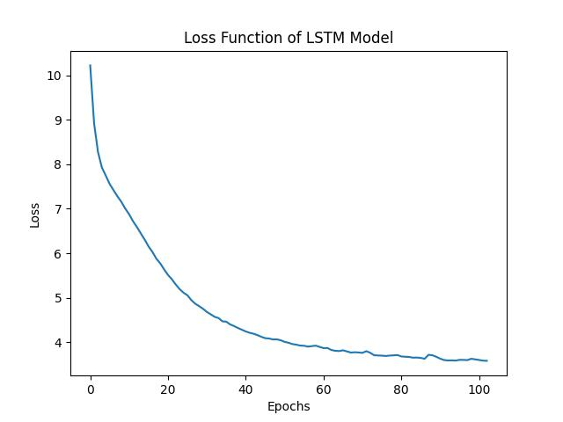
Results from Enhanced Model Training
Fig 9:- Plotting “loss curve” vs “epochs” for BLSTM model

Slide 26
Y-axis : Loss value
X-axis : Number of epochs
The decrease in loss in the second graph is much significant compared to the previous one. Here the loss is reduced to approx 3.5 after a little more than 100 epochs which ended due to the early stopping mechanism due to lack of change in the loss value.

Slide 27

Song Generation Video

Slide 28

Other Generated Songs
Sample 1
Sample 2
Sample 3

Slide 29
Conclusion
The model generation and training phases are completed. The below things can be addressed in the future regarding the project
Making a better model with higher accuracy and lower loss
Creation of multiple models and comparing the results of each of the models created
The model can be used to generate songs of other instruments and not just restrict with the piano instrument. Multiple instruments can be used at the same time and combined to create a better sounding tune.

Slide 30
Although the model will be able to generate music, it may not sound as good compared to other man-made songs. However, it is still a step forward in reaching the goal where an AI can make music which sounds better than most of the existing songs. It may not be possible to make rhythms sounding better than most of the masterpiece, but in the distant future, music generation AI will definitely create soundtracks which sounds different and would inspire many other creators to go towards a different direction in composing music. It would give ideas and show the potential of music and how it can be different even after a long period of time. The applications which contain music generation AI will help ordinary people to create music, solely based on their creative thinking without the constraints of learning a new instrument.

Slide 31
References
Research Papers
Nayebi, A., & Vitelli, M. (2015). Gruv: Algorithmic music generation using recurrent neural networks. Course CS224D: Deep Learning for Natural Language Processing (Stanford).
Huang, Y., Huang, X., & Cai, Q. (2018). Music Generation Based on Convolution-LSTM. Comput. Inf. Sci., 11(3), 50-56.
Mangal, S., Modak, R., & Joshi, P. (2019). Lstm-based music generation system. arXiv preprint arXiv:1908.01080.
Shi, Z., Arul, K., & Smith III, J. O. (2017). Modeling and Digitizing Reproducing Piano Rolls. In ISMIR (pp. 197-203).
Raffel, C., & Ellis, D. P. (2016, August). Extracting Ground-Truth Information from MIDI Files: A MIDIfesto. In ISMIR (pp. 796-802).

Slide 32
References
Dataset
Soumik Rakshit (2019). Classical Music MIDI. Kaggle
Retrieved from kaggle.com/soumikrakshit/classical-music-midi
Webpage. Free Scale Chords Pack. FeelyourSoul
Retrieved from feelyoursound.com/scale-chords
Giant Midi Piano Dataset
Retrieved from github.com/bytedance/GiantMIDI-Piano

Slide 33
References
Figures
Fig 1: Image of dataset files
Retrieved from https://www.kaggle.com/soumikrakshit/classical-music-midi
Fig 2: Example of a Piano Roll
Retrieved from researchgate.net/figure/Example-of-symbolic-piano-roll
Fig 3: Basic architecture of the LSTM Model
Retrieved from hindawi.com/journals/complexity/2021/9903518/

Slide 34
Thank You

